Slide 1
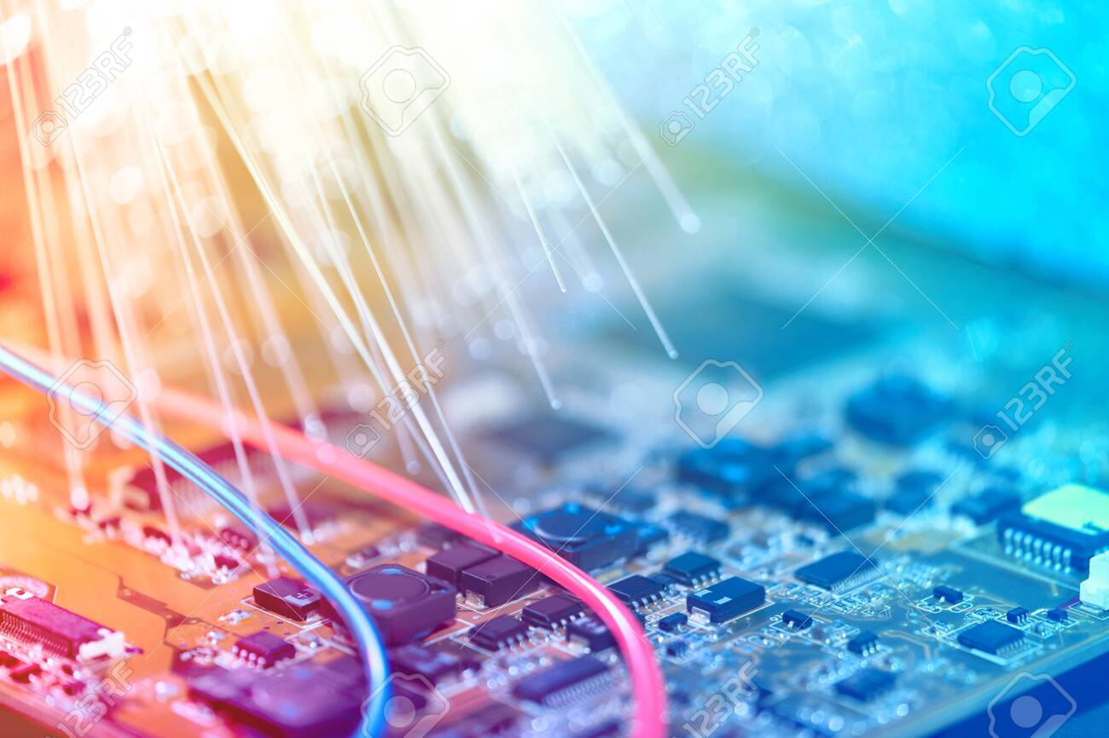


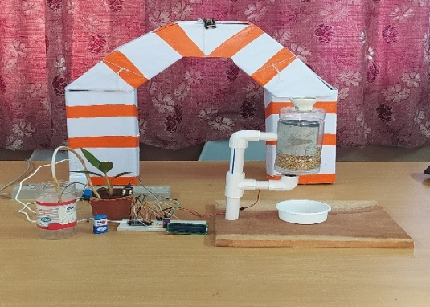
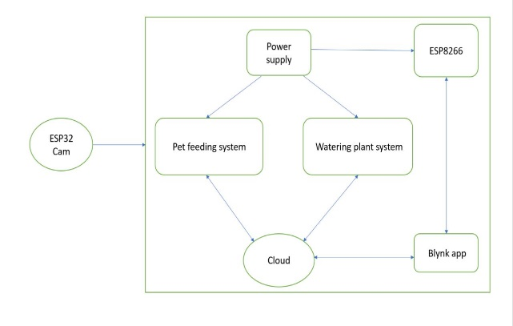
IOT BASED SMART WAY OF WATERING PLANTS AND FEEDING PETS
Guide: Mr. R V H Prasad M.Tech., (Ph.D) , Assistant Professor, Dept. of E.C.E
ABSTRACT :
Plants and animals are most essential in our livelihood . Like human beings, additionally they need water supply and food supply to survive. But is not is not possibly to take care every time. We chose this project to provide convenience to owner by helping them feed their pets and water the plants through their phone.
OBJECTIVE:
To feed the pets and water the plants remotely in a smart way.
● Owners will be able to provide food through the app itself.
● Owners will be able to monitor their pet’s and plants health condition recorded by the ESP32 CAM .
BLOCK DIAGRAM:
.
RESULT:
The combined system of pets and plants through which users can provide food and water using Blynk App on their mobile. When the pets require food the owner moves this slider to dispense food from food dispenser. The soil moisture sensor detects when the soil becomes dry based on the threshold value and then the user switches on the water pump to supply water for the plant.
BENEFITS:
Provide food and water at exact time.
Adjustable food distribution for pets.
Adjustable water distribution for plants.
The phone app could record the video through ESP32 cam.
Conclusion:
Hence, the designed a model that is based on the Internet of Things helps all the pet and plant caretakers in a smart way by providing some necessary amount of food and water. The purpose of this project is to control and monitor the pets and
METHODOLOGY:
This method supports both food supply to the pet and water supply to the plant through Blynk mobile application. With the use of the ESP32 CAM module users can monitor the pet, plant and their surroundings. These mechanisms are to be done at a time when the user enables the slider option and button option in the Blynk mobile application.
Presented by:
V. Soniya - 198W1A0458
SK. Karishma - 198W1A0452
D. Vamsi - 198W1A0416
K. Ravi Shankar - 198W1A0431

